Slide 1
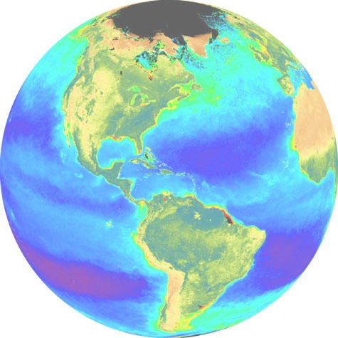
Developing a Geoscience and Remote Sensing Laboratory as a Pathway to Earth SySTEM Education
Satellite and Education Conference
Madison, Wisconsin
August 1, 2014
John D. Moore
Einstein Fellow Emeritus
President-Elect, National Earth Science Teachers Association
Chair, AMS Board on Outreach and Precollege Education
Executive Director, American Council of STEM Educators
mr.moore.john@gmail.com

Slide 2
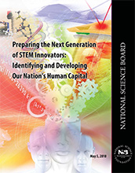
National Initiatives
PCAST K-12 STEM Education Report
“PREPARE and INSPIRE”
National Academy of Sciences
“Successful K-12 STEM Schools”
National Science Foundation
“Preparing the Next Generation of STEM Innovators”
Next Generation Science Standards (NGSS)
American Meteorological Society
“Earth System STEM Education
Policy Statement”

Slide 3
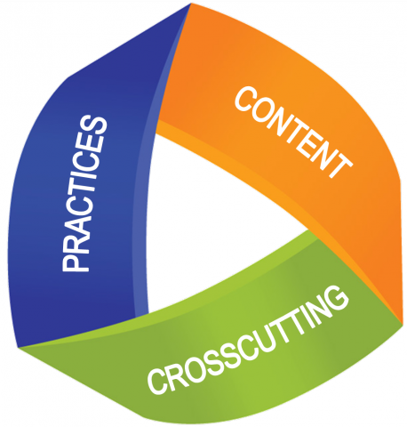
NGSS … Shift in Pedagogy
K–12 Science Education should reflect the Real World Interconnections in Science.
Using all practices and crosscutting concepts to teach all core ideas all year.
Science Concepts build coherently across K–12.
NGSS focus on deeper understanding and application of content.
Science and Engineering are integrated in Science Education from K–12.
Inclusion of the Earth and Space Sciences.

Slide 4
As we face future natural and human generated hazards and disasters, the Geosciences have a critical role in the public awareness, safety, and national security of our nation. This past year, we have experienced volcanoes, earthquakes, tsunamis, hurricanes, tornadoes, and severe flooding, yet it is becoming increasing more difficult to find opportunities in K-12 education for students to engage in relevant related studies. What implications will this have on the 21st Century workforce? Teachers are using satellite and remote sensing technologies to incorporate imagery, data, and real time observations in the classroom. Geographic Information Systems content is being taught as a technical skill, and is used to develop “Geospatial Thinking” in problem solving. Today, pre-college students and teachers are collaborating with the commercial aerospace industry and NASA to build “CubeSats”, ready for spaceflight, creating authentic science experiences. Students are engaged in observing the Earth and visualizing their future. Our community has an opportunity to inform policy makers in the development of emerging national STEM Education initiatives. The interdisciplinary nature of our discipline lends itself to providing the required leadership. Therefore, it is imperative that any plan for “Creating a National Strategy for Environmental Intelligence” highlight education as a fundamental component.
(The Forum On Earth Observations V , 14 June 2011)

Slide 5
SCIENCE vs. SCIENCE EDUCATION
National Economy
National Security
National Geoscience
Related Events

Slide 6
4 –yr. Colleges and Universities
… and beyond
Community Colleges
K-12 and Career Technical Education
Future Workforce Development

Slide 7
Generate a
“Conduit for Excellence”
Identify and Develop Professional Development Opportunities
Develop the
“Teacher’s Voice”
Expand the
Teacher’s Knowledge Base
Content – Policy-Practice
Collaborate with Industry
Develop Professional Standards for Master STEM Educators and Membership
Implement the
“Teacher to Teacher Initiative”
Collaborate with Educational and Professional Organizations
EXPERIENCE and
LEADERSHIP

Slide 8
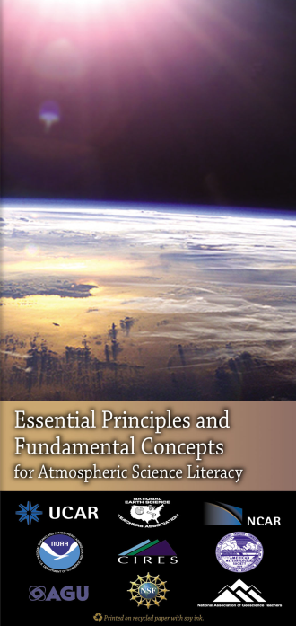
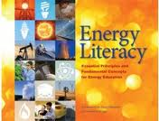
Geoscience Literacy
Earth
Oceans
Atmosphere
Climate
Energy

Slide 9
Big Data
Notes:
Credit Peter Baumann, EarthServer.eu

Slide 10
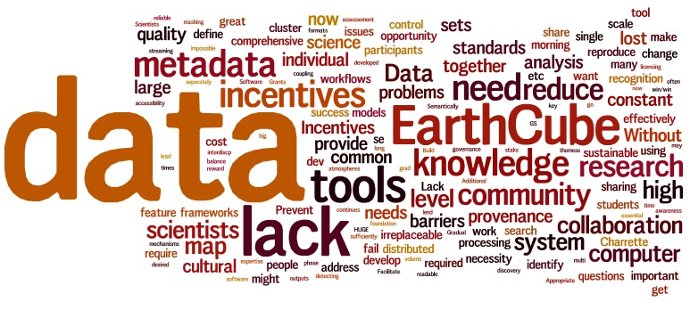

Slide 11
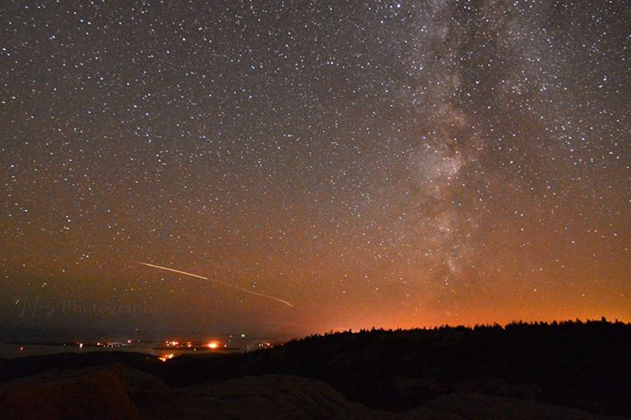
LET THE FUTURE BEGIN

Slide 12
Earth and Space Science
Earth SySTEM
Geosciences
Environmental Science
Earth System Science

Slide 13
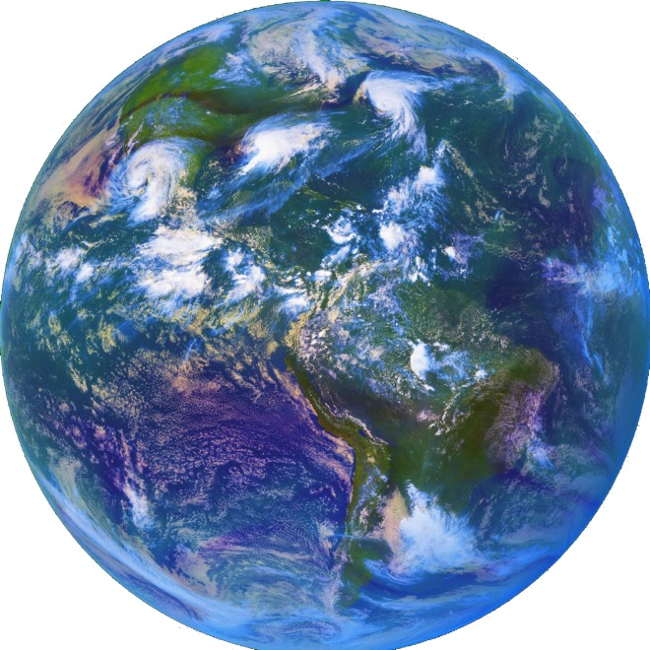
Earth SySTEM Education*
Applications of the
Geosciences* in Science,
Technology, Engineering, and
Mathematics (STEM) Education, Earth SySTEM, utilize satellite imagery, remote sensing technology, real-time data, and computer visualizations to facilitate interactions between STEM disciplines.
* Geoscience as defined by the NSF …
Earth-Oceans-Atmosphere/Space
* AMS Earth System STEM Education Policy Statement

Slide 14
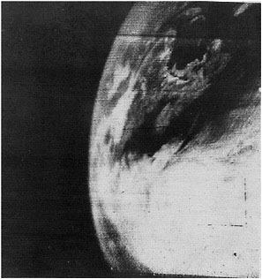
Geoscience and Earth Systems STEM Education: Earth SySTEM

Slide 15
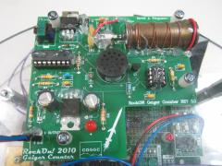
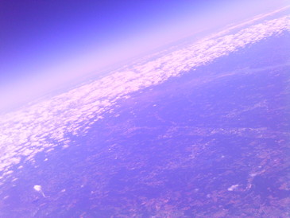
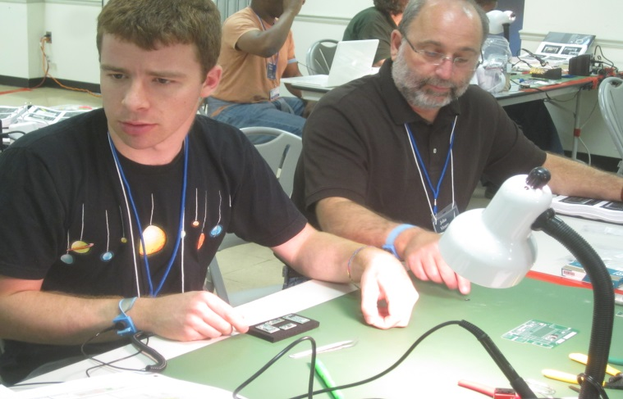
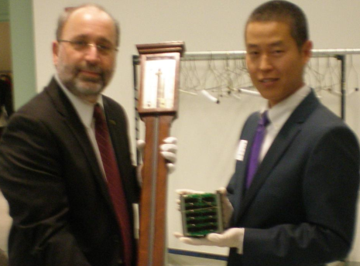
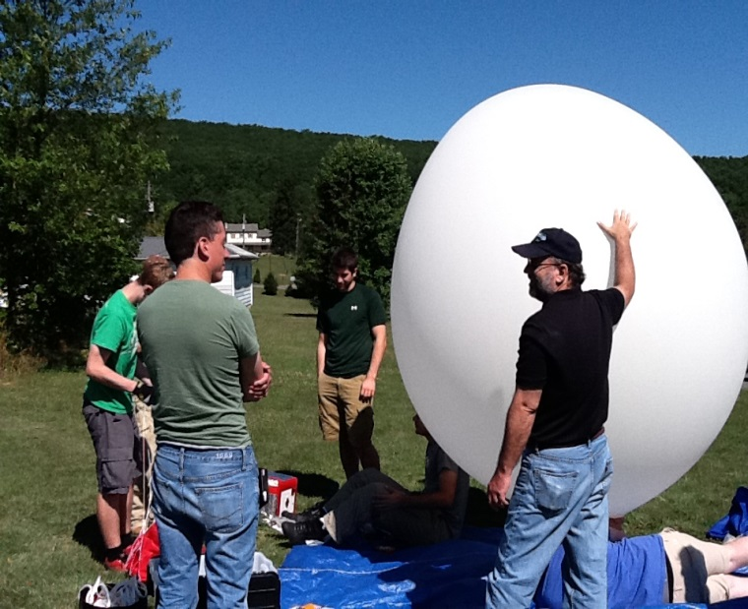
Science -Technology -Engineering – Mathematics Next Generation Earth Systems Education

Slide 16
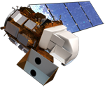
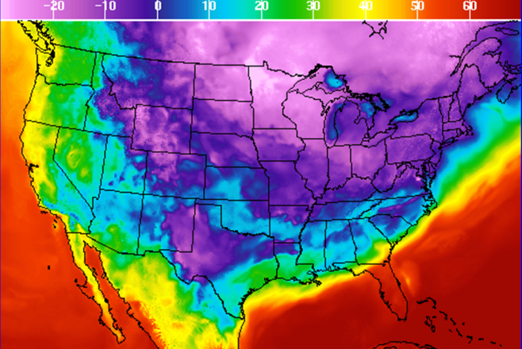
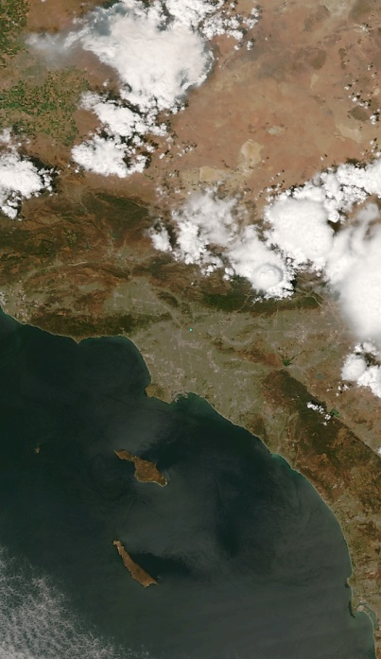
Geoscience and Remote
Sensing Laboratory
Real-Time Data
Google Earth Display
Geographic Information System (GIS)
Image Analysis
Study Earth as a System
Monitoring
Field Observations and Data Collection

Slide 17
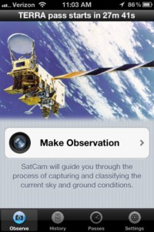
SPACE-EARTH : EARTH-SPACE
Students now have the ability to
examine a geo-referenced location from the
top-down and bottom-up
An Integrated “SEES”
Earth SySTEM Educational Model
Fosters Geospatial Thinking
Identifies geo-referenced data
points/sources
Incorporates Real-time Data
Develops Geoscience and Remote Sensing content
and applications

Slide 18
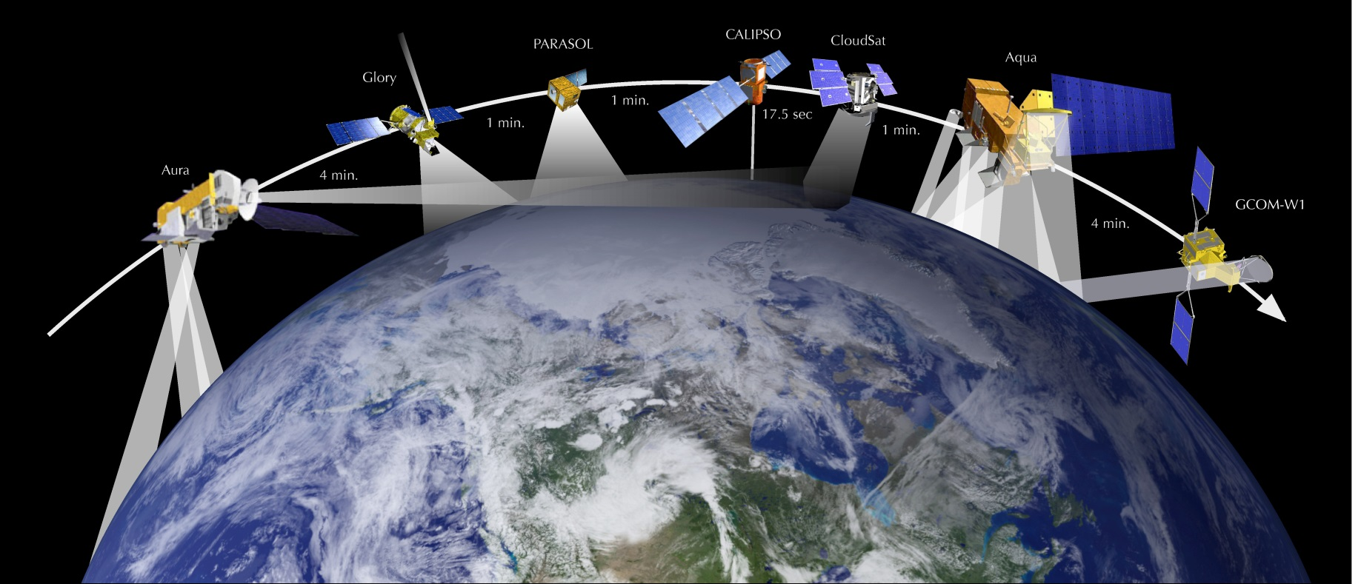
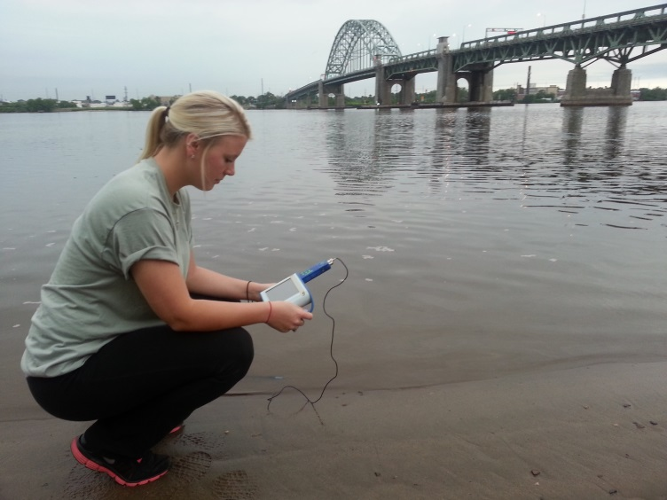
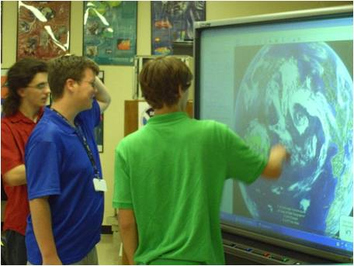
SPACE TO EARTH : EARTH TO SPACE (SEES)

Slide 19
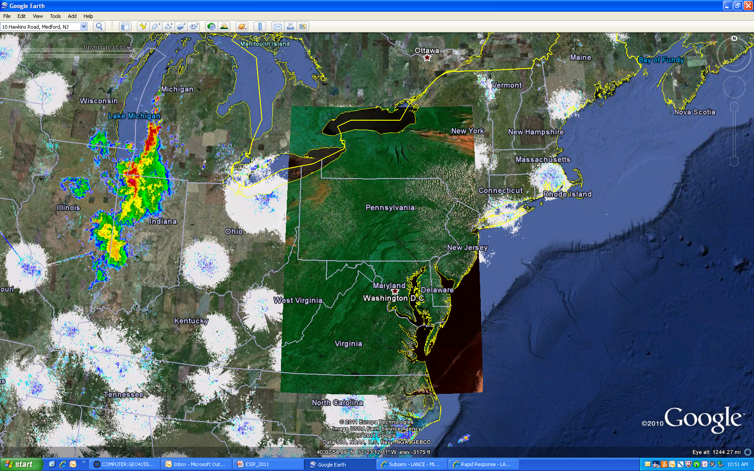

Slide 20
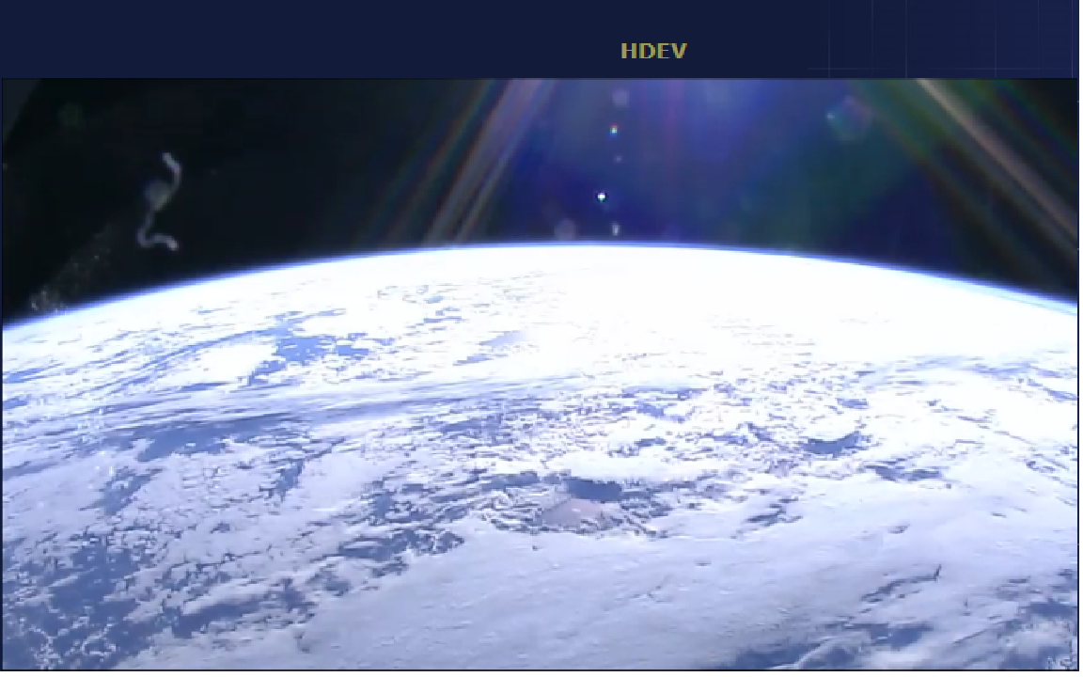
Real Time ISS HD Imagery

Slide 21
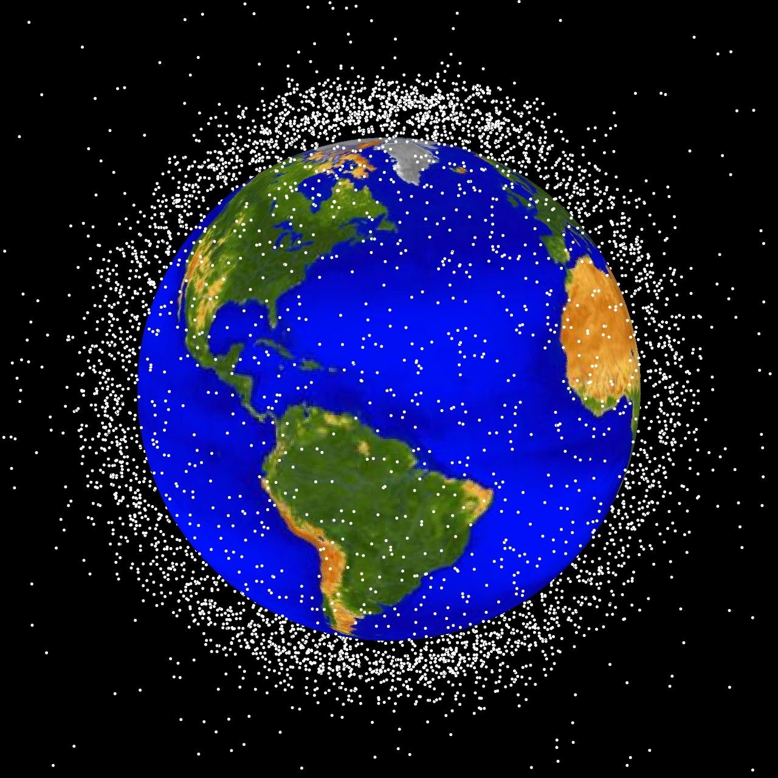

Slide 22
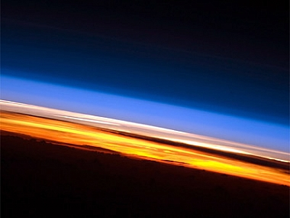
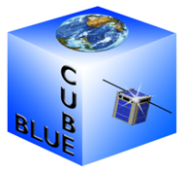
To Observe the Earth and Visualize the Future …
A New Era of Observations
BLUECUBE
Build - Launch - Utilize - Educate

Slide 23
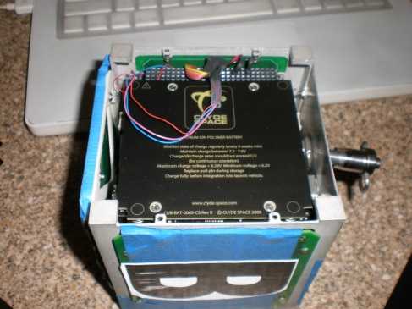
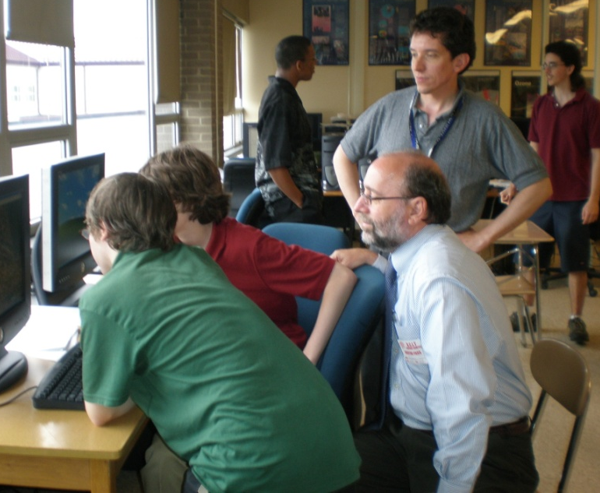
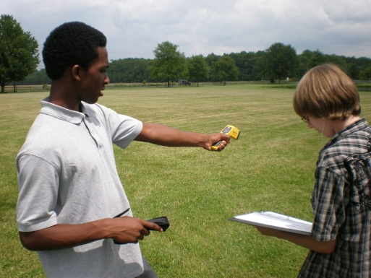
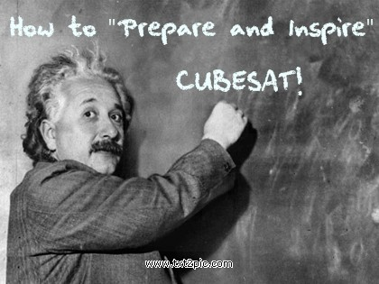
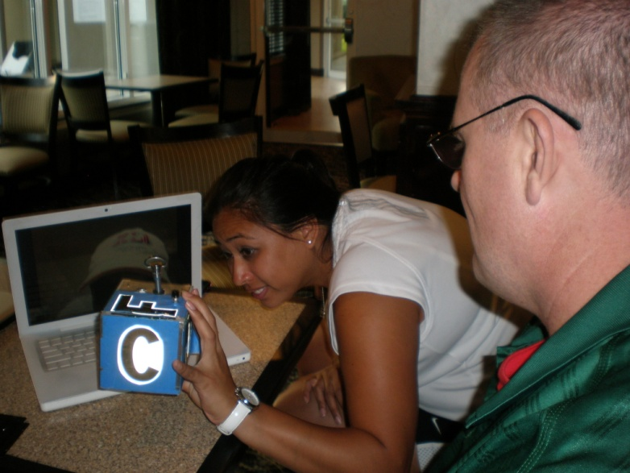
Prepare and Inspire

Slide 24
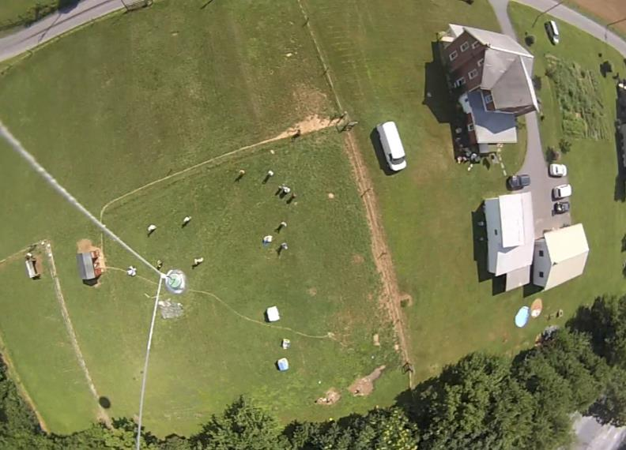
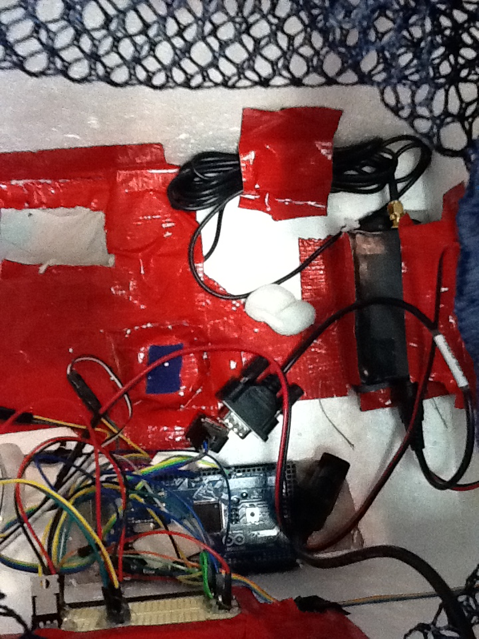
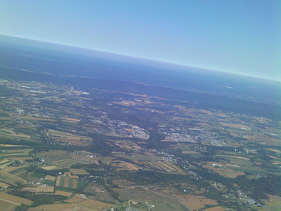
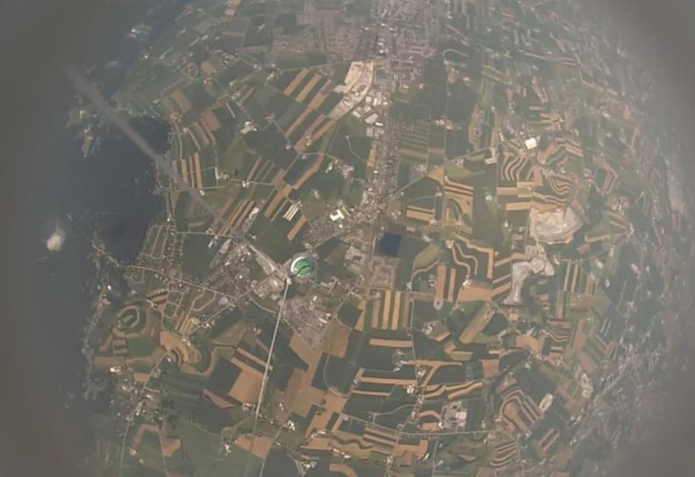

Slide 25
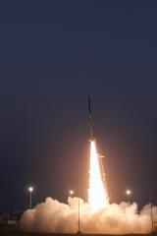
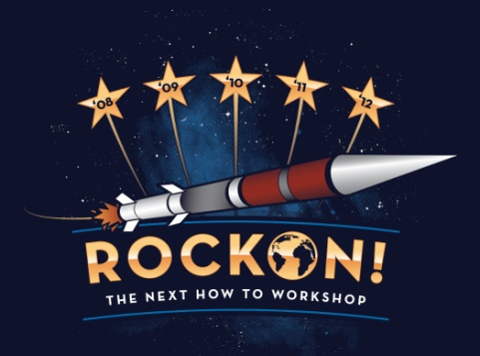
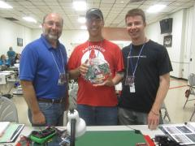
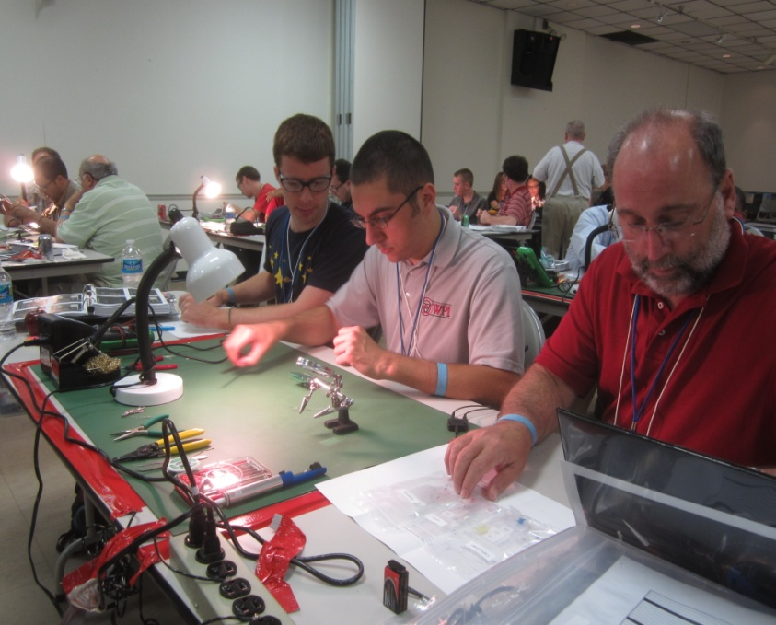

Slide 26
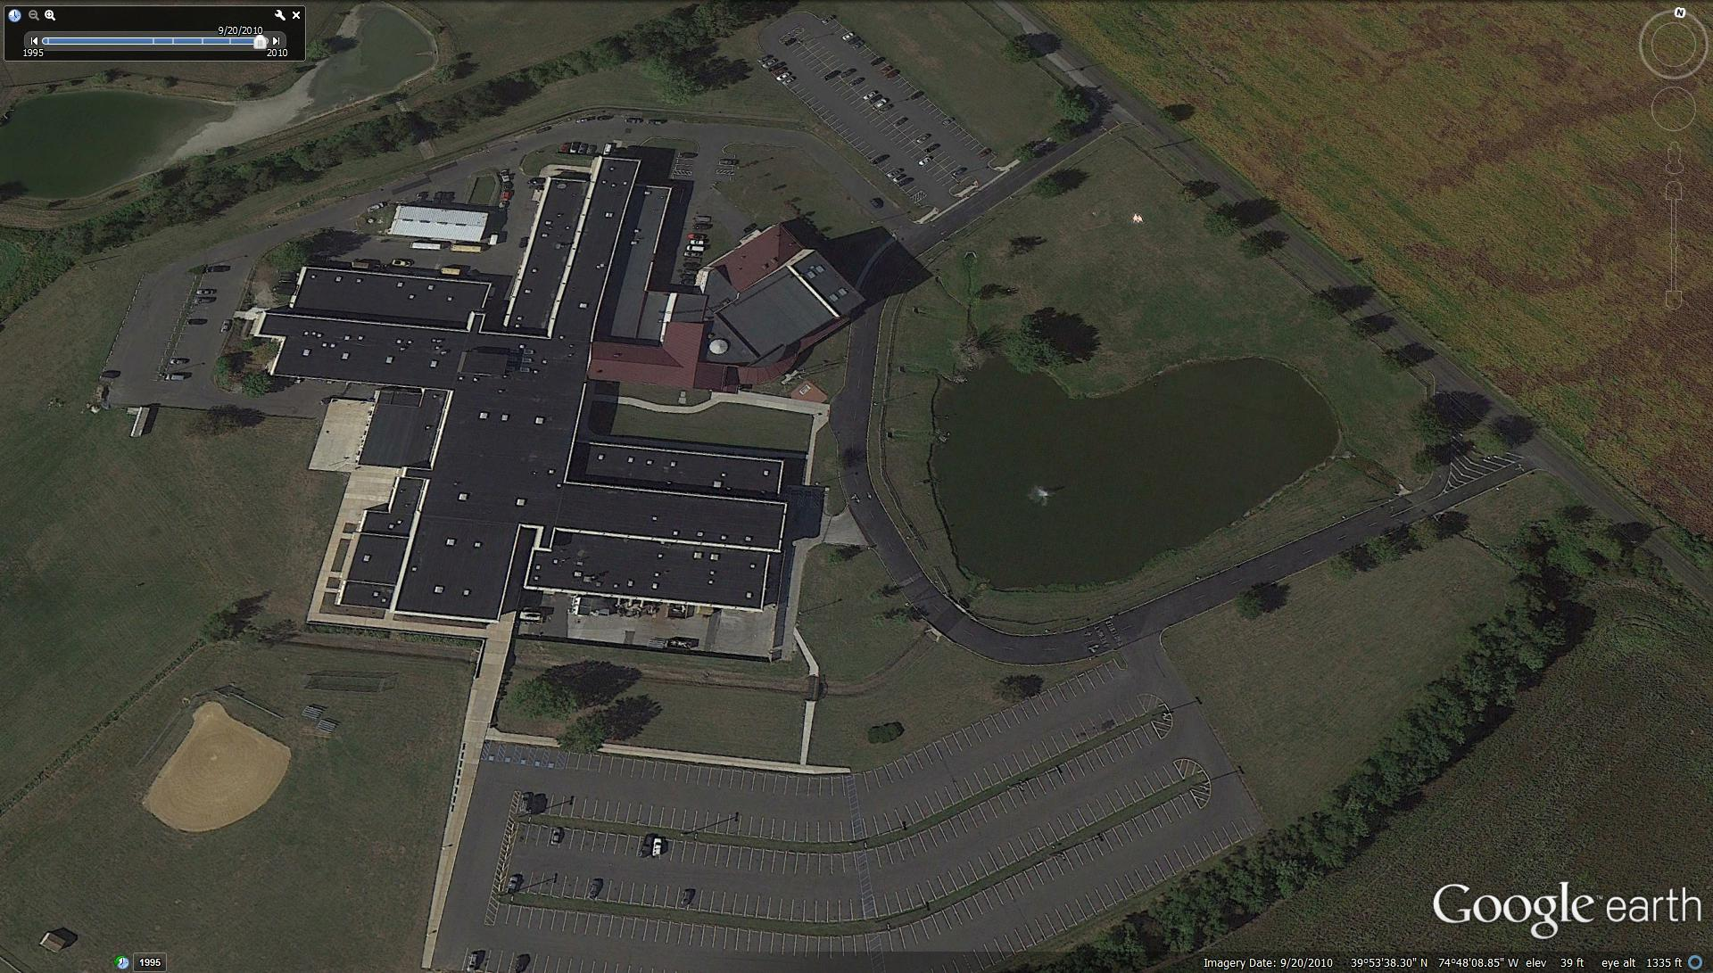
Geospatial Intelligence

Slide 27
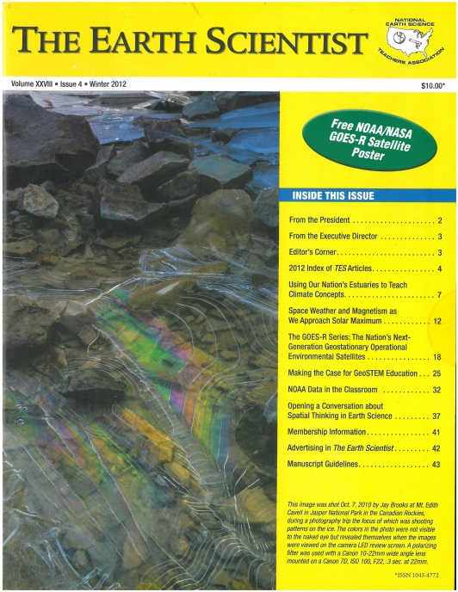
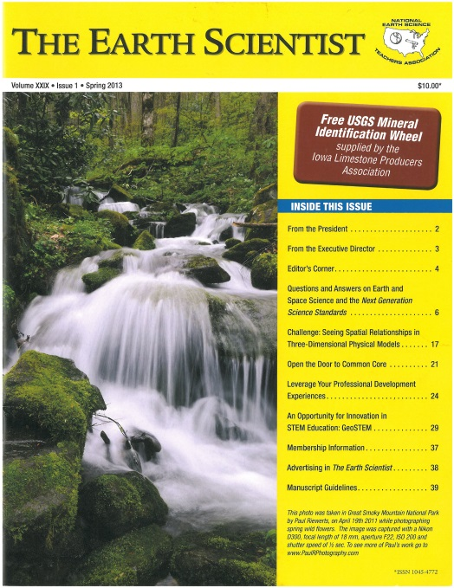
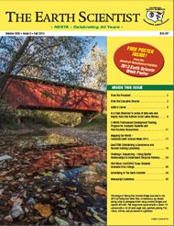
www.nestanet.org
“Making the Case for GeoSTEM Education”
“An Opportunity for Innovation in STEM Education: GeoSTEM”
“GeoSTEM: Establishing a Geoscience and Remote Sensing Laboratory”

Slide 28
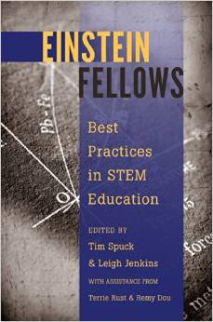
It is a miracle that curiosity survives formal education. Albert Einstein
JOHN D. MOORE
mr.moore.john@gmail.com

